Slide 1
3D Computer Vision
Dr. Hassan Foroosh
School of EECS
UCF

Slide 2
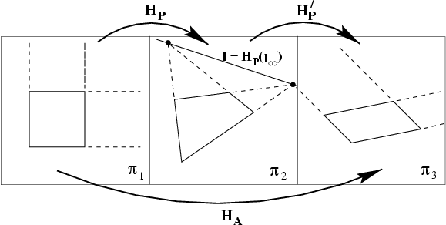


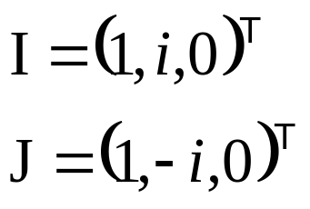
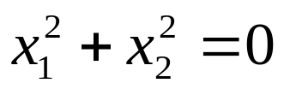
Last Time …
projection
rectification
“circular points”

Slide 3
Recovering metric properties from images
Angles
Length ratios

Slide 4
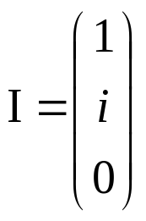
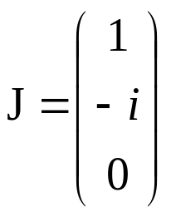
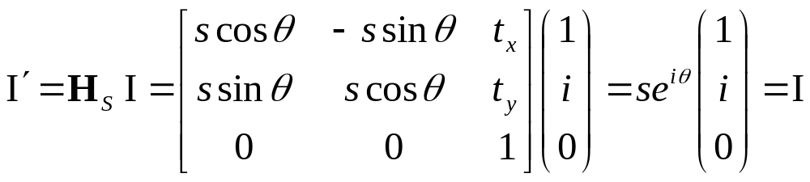
Reminder:
The circular points
The circular points I, J are fixed points under the projective transformation H iff H is a similarity

Slide 5
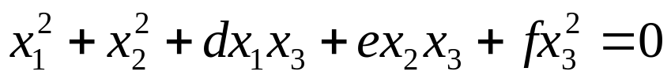
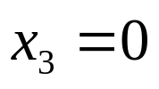
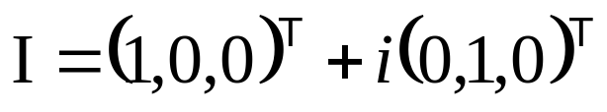
The circular points
“circular points”
l∞
Algebraically, encodes orthogonal directions

Slide 6
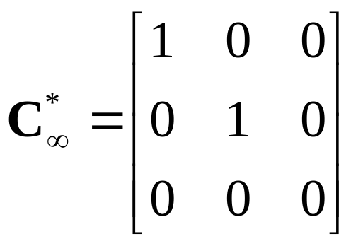
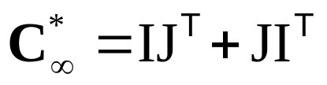
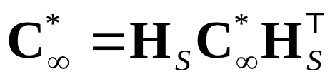
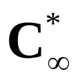
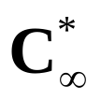
Conic dual to the circular points
The dual conic is fixed conic under the
projective transformation H iff H is a similarity
Note: has 4DOF
l∞ is the nullvector

Slide 7
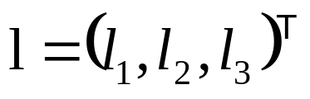
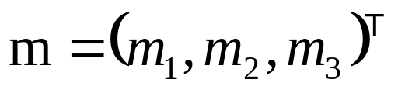
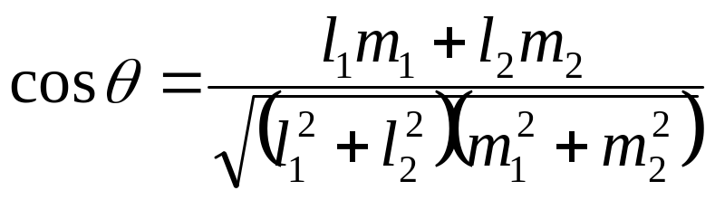
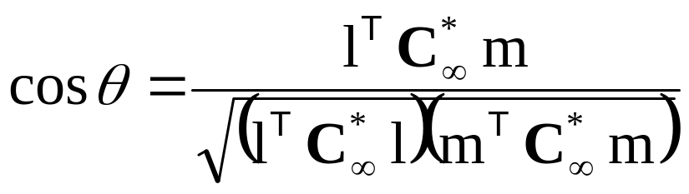
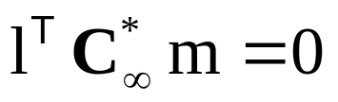
Angles
Euclidean:
Projective:
(orthogonal)

Slide 8
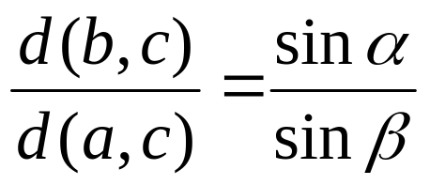
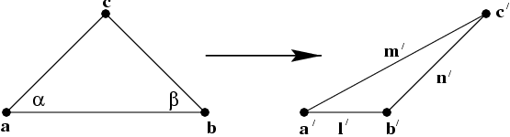
Length ratios

Slide 9
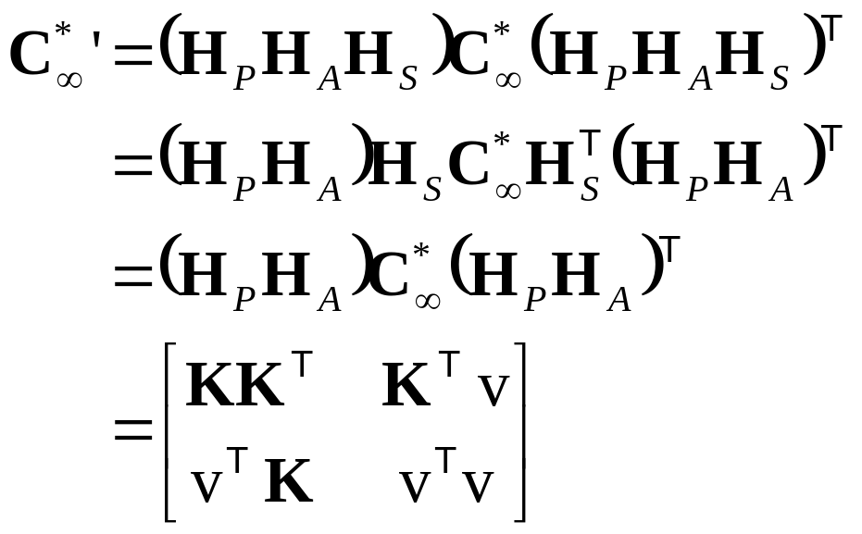
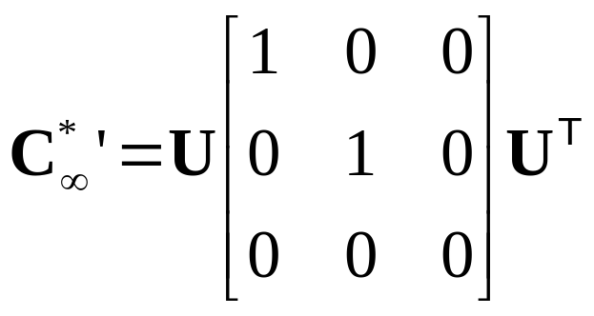

Metric properties from images
Rectifying transformation from SVD

Slide 10
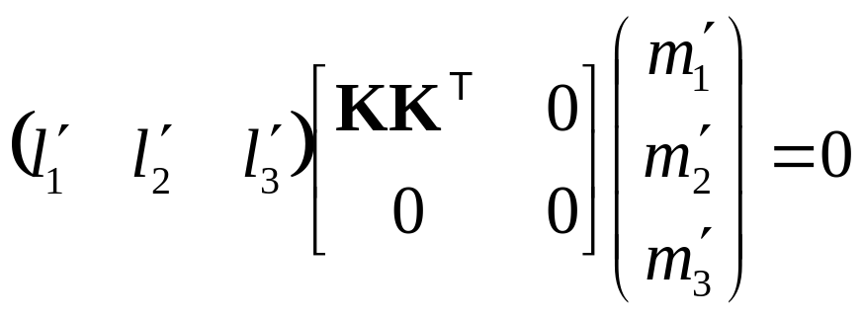
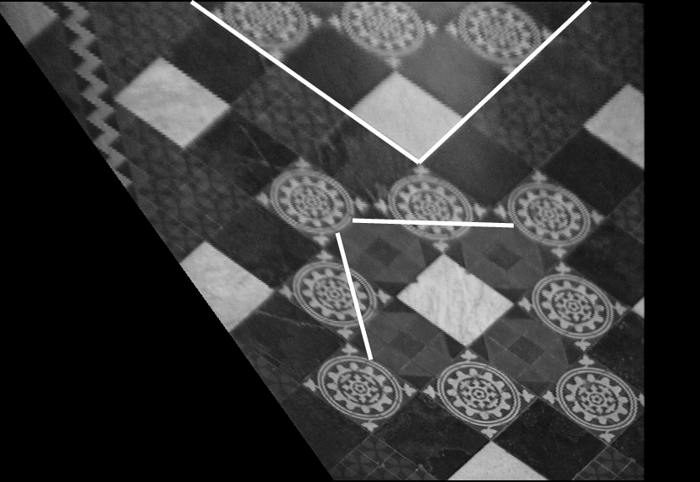
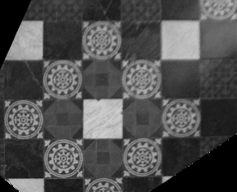
Metric from affine

Slide 11
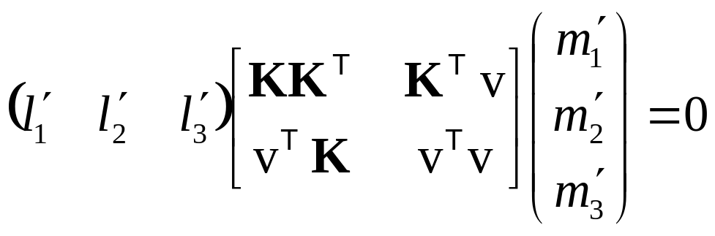
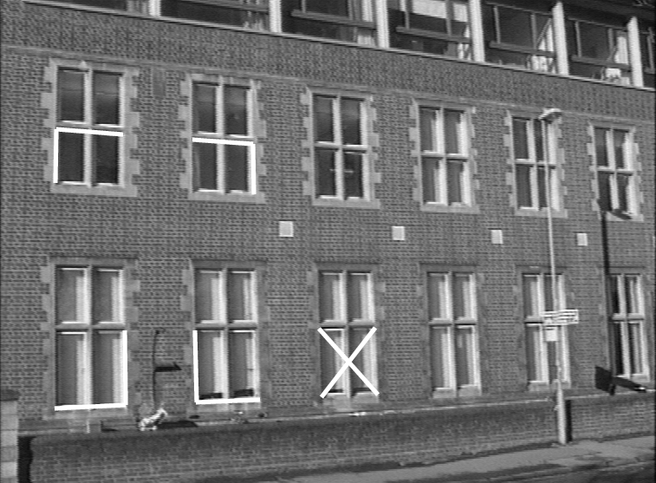
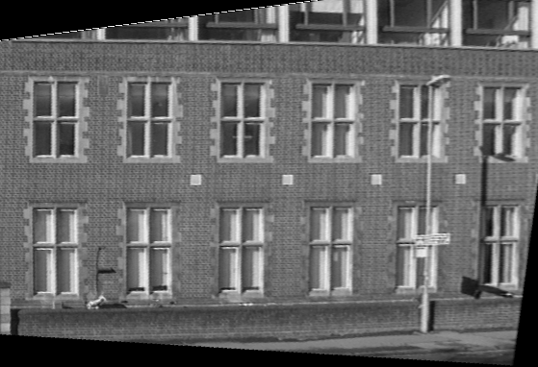
Metric from projective

Slide 12
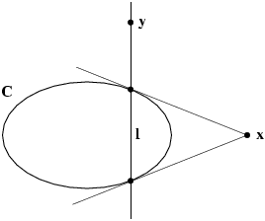
Pole-polar relationship
The polar line l=Cx of the point x with respect to the conic C intersects the conic in two points. The two lines tangent to C at these points intersect at x

Slide 13
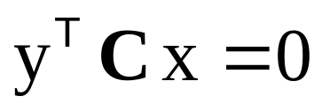
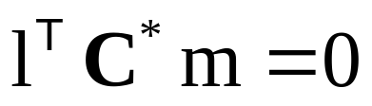
Correlations and conjugate points
A correlation is an invertible mapping from points of P² to lines of P². It is represented by a 3x3 non-singular matrix A as l=Ax
Conjugate points with respect to C
(on each others polar)
Conjugate points
with respect to C*
(through each others pole)

Slide 14








Projective conic classification
Diagonal | Equation | Conic type
(1,1,1) |  | improper conic
(1,1,-1) |  | circle
(1,1,0) |  | single real point
(1,-1,0) |  | two lines
(1,0,0) |  | single line

Slide 15
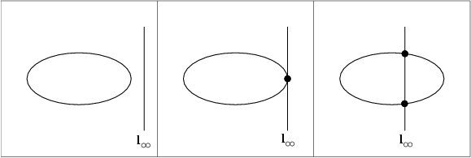
Affine conic classification
ellipse
parabola
hyperbola

Slide 16
Chasles’ theorem
Conic = locus of constant cross-ratio towards 4 ref. points
A
B
C
X
D

Slide 17
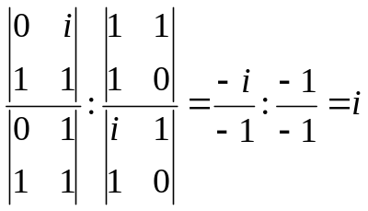
Iso-disparity curves
X_{i}
X_{j}
X₀
X₁
C₁
C₂
X∞

Slide 18
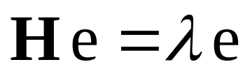
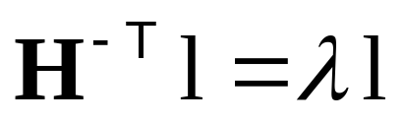
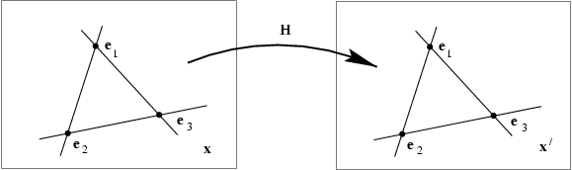
Fixed points and lines
(eigenvectors H =fixed points)
(λ₁=λ₂ ⇒ pointwise fixed line)
(eigenvectors H^{-T} =fixed lines)

